Slide 2
Seafood at Its Best
Lesson 2
Health Benefits
“Seafood Platter” by Tom O’Malley
Notes:
Health Benefits (slide 2)
Welcome to lesson 2 of Seafood at Its Best. Today you will learn about the health benefits of eating seafood.

Slide 3
Lesson 2 Goals
To learn about the health benefits of eating seafood.
3
Notes:
Lesson 2 Goals (slide 3)
The goal of lesson 2 is to learn about the health benefits of eating seafood.

Slide 4
Lesson 2 Objectives
Increase knowledge of the following:
2010 Dietary Guidelines
Health benefits of seafood
Seafood serving recommendations
4
Notes:
Lesson 2 Objectives (slide 4)
The objectives are to increase your knowledge of the 2010 Dietary Guidelines, the health benefits of eating seafood, and seafood serving recommendations.
Before we begin, I would like you to take a few minutes to complete the pretest.
Instructor: Pass out lesson 2 pretest.

Slide 5
2010 Dietary Guidelines for Americans Key Recommendations
Increase the amount and variety of seafood consumed by choosing seafood in place of some meat and poultry
Consume 8 to 12 ounces of seafood per week from a variety of seafood types
5
Notes:
2010 Dietary Guidelines for Americans (slide 5)
By law, the Dietary Guidelines for Americans is reviewed, updated if necessary and published every 5 years. The benefits of seafood are so great that the 2010 government guidelines for Americans recommend that average Americans increase their seafood intake to at least 8 ounces a week, or about two servings. The serving size for children is 3 to 6 ounces. The Department of Health and Human Services say adults now consume only about 3 ½ ounces a week.
The Dietary Guidelines recommendations traditionally have been intended for healthy Americans ages 2 years and older. However, the 2010 Dietary Guidelines for Americans is being released at a time of rising concern about the health of the American population. Poor diet and physical inactivity are the most important factors contributing to an epidemic of overweight and obesity affecting men, women, and children in all segments of our society. Even in the absence of overweight, poor diet and physical inactivity are associated with major causes of morbidity and mortality in the United States. Therefore, the 2010 Dietary Guidelines is intended for Americans ages 2 years and older, including those at increased risk of chronic disease.
The health benefits of seafood are becoming increasingly well known. Research scientists and health organizations worldwide, including the U.S. Dietary Guidelines Advisory Committee and the American Heart Association, recommend adding seafood to the diet as a good source of omega-3 fatty acids (EPA and DHA). Omega-3 fatty acids are compounds that have been shown to be beneficial to heart health and early neurological development.

Slide 6
Seafood Recommendations Pregnant and Breast Feeding Women
Dietary Guidelines emphasizes that pregnant and breastfeeding women should eat seafood
Eat at least 8 ounces of a variety of seafood and up to 12 ounces per week
6
Notes:
Seafood Recommendations for Pregnant and Breast Feeding Women (slide 6)
In addition to the health benefits for the general public, this is the first time the Dietary Guidelines have recommended a specific amount of seafood to eat, the nutritional value of seafood is of particular importance during fetal growth and development, as well as in early infancy and childhood.
Moderate evidence indicates that intake of omega-3 fatty acids, in particular DHA, from at least 8 ounces of seafood is associated with improved infant health outcomes, such as visual and cognitive development. Therefore, it is recommended that women who are pregnant or breastfeeding consume at least 8 and up to 12 ounces of a variety of seafood per week, from choices that are lower in methyl mercury. Obstetricians and pediatricians should provide guidance to women who are pregnant or breastfeeding to help them make healthy food choices that include seafood.
Women who are pregnant or breastfeeding should not eat four types of fish because they are high in methyl mercury. These are tilefish, shark, swordfish, and king mackerel. Women who are breastfeeding can eat all types of tuna, including white (albacore) and light canned tuna, but should limit white tuna to 6 ounces per week because it is higher in methyl mercury.

Slide 7
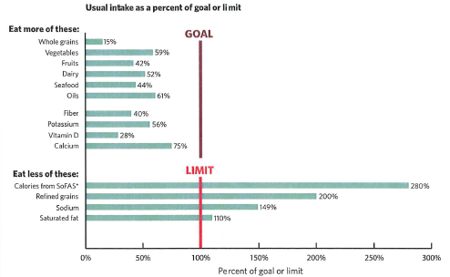
Typical American Diet Intake
7
Notes:
Typical American Diet Intake (slide 7)
This graph shows how the typical American diet compares to recommended intakes or limits. This is for all individuals (ages 1 or 2 years or older, depending on the data source).
The new Dietary Guidelines supports the recommendation to consume seafood for the total package of benefits that seafood provides, including its EPA and DHA content.
The mean intake of seafood in the United States is approximately 3 ½ ounces per week, and increased intake is recommended. Recommended to increase intake by replacing some meat or poultry with seafood.

Slide 8
2010 Dietary Guidelines for Americans Two Basic Concepts
Maintain calorie balance over time to achieve and sustain a healthy weight
Focus on consuming nutrient-dense foods and beverages
www.dietaryguidelines.gov
www.choosemyplate.gov
8
Notes:
2010 Dietary Guidelines (slide 8)
The Dietary Guidelines for Americans (DGA) established the direction for all government nutrition programs, including research, education, and food assistance. The Dietary Guidelines provide science-based advice to promote health and to reduce the risk for major chronic diseases through diet and physical activity. The Dietary Guidelines can be found at www.health.gov/dietaryguidelines.
The Dietary Guidelines for Americans are a joint effort of the U.S. Department of Health and Human Services (HHS) and the U.S. Department of Agriculture (USDA).
The two basic concepts of the Dietary Guidelines are:
Maintain a calorie balance over time to achieve and sustain a healthy weight
Focus on consuming nutrient-dense foods and beverages
Eating and physical activity patterns that are focused on consuming fewer calories, making informed food choices, and being physically active can help people attain and maintain a healthy weight, reduce their risk of chronic disease, and promote overall health.
Prevent and/or reduce overweight and obesity through improved eating and physical activity behaviors.
Control total calorie intake to manage body weight. For people who are overweight or obese, this will mean consuming fewer calories from foods and beverages.
Increase physical activity and reduce time spent in sedentary behaviors.
Maintain appropriate calorie balance during each state of life – childhood, adolescence, adulthood, pregnancy and breastfeeding and older age.
Instructor: Show the MyPlate: www.myplate.gov

Slide 9
Seafood is Nutrient-Dense
Seafood is nutrient-rich, meaning it packs healthy nutrients including omega-3s into less than a couple of hundred calories per 3-ounce serving
A healthy eating pattern focuses on nutrient-dense foods such as seafood
9
Notes:
Seafood is Nutrient-Dense (slide 9)
Food choices that should be emphasized to help Americans close nutrient gaps and move toward healthy eating patterns include consuming nutrient-dense foods.
The Dietary Guidelines once again stress consuming nutrient-dense foods – meaning the nutrients have not been diluted by the addition of calories from added fats and sugars. Nutrient dense foods are lean or low in solid fat, sugars and sodium. Nutrient dense foods provide vitamins, minerals, and other substances that may have positive health effects, with relatively few calories.

Slide 10
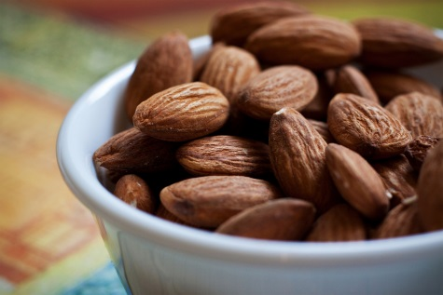
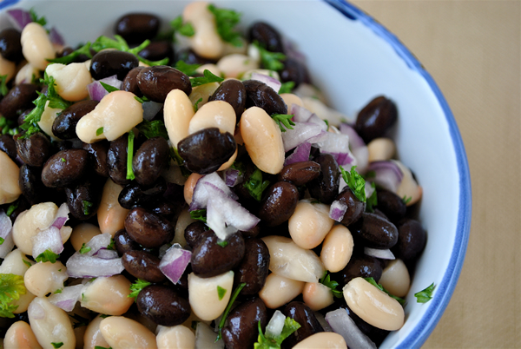
Choose a Variety of Protein Foods
Choose a variety of protein foods, which include seafood, lean meat and poultry, eggs, beans and peas, soy products and unsalted nuts and seeds
Bake, broil or grill it
“Colorful Eggs” by Andy Melton
“Nutty Browns” by Nomadic Lass
“Black & White Bean Salad” by Cookbookman17
“Met Scallops” by Ralph Daily
“Roast Chook…” by Jules
“Filet Mignon” by Neeta Lind
10
Notes:
Choose a variety of Protein foods (slide 10)
The Dietary Guidelines recommendations as part of a healthy eating pattern while staying within their calorie needs recommends choosing a variety of protein foods, which include seafood, lean meat and poultry, eggs, beans and peas, soy products and unsalted nuts and seeds.
In addition to protein, these foods contribute B vitamins (niacin, thiamin, riboflavin, and B6), vitamin E, iron, zinc, and magnesium to the diet. However, protein also is found in some foods that are classified in other food groups, such as milk and milk products. The fats in meat, poultry and eggs are considered solid fats, while the fats in seafood, nuts and seeds are considered oils. Meat and poultry should be consumed in lean forms to decrease intake of solid fats.
Keep it lean—broil, grill, roast, poach, or boil meat, poultry, or fish instead of frying. Skip or limit the breading on meat, poultry, or fish. Breading adds fat and calories. It also will cause the food to soak up more fat during frying.
Vary your protein choices—choose fish more often for lunch or dinner. Look for fish rich in omega-3 fatty acids, such as salmon, trout, and herring. Some ideas are salmon steak or fillet, salmon loaf, or grilled or baked trout.

Slide 11
Nutritional Benefits
High-quality protein
High in omega-3 fatty acids
Low in saturated fat
Source of vitamins and minerals
“Sesame Crusted Ahi Tuna…” by Ralph Daily
11
Notes:
Seafood—Nutritional Benefits (slide 11)
We have known for years that seafood is a good source of protein and a low-calorie food. Today, through the educational and promotional efforts of the seafood industry, government, and academe, the general public has a sharper sense of the importance of seafood in a healthy diet. Seafood can make a significant contribution to the nutrient needs of all consumers, especially growing children and the elderly.
Seafood is considered the best dietary source of omega-3 fatty acids, although some plants and plant oils contain lesser amounts. All fish and shellfish contain some omega-3s.
Seafood is low in total fat, saturated fat, and cholesterol. Seafood is a good source of vitamins and minerals.

Slide 12
High-Quality Protein
Protein needed for growth and maintenance
Seafood contains all 9 essential amino acids
Protein is highly digestible
Fish contain 16-27 grams of protein
“Cod…” by Anjuli Ayer
12
Notes:
High-Quality Protein (slide 12)
Proteins are large molecules composed primarily of amino acids. Our bodies’ digestive enzymes break down the protein we consume to release amino acids, which in turn make new proteins the body uses for growth and maintenance.
There are nine amino acids that the body cannot manufacture; we must get them from food. They are called essential amino acids.
Seafood contains all nine essential amino acids; it is an excellent choice for meeting our daily protein needs.
An added advantage of seafood is its protein is highly digestible. The protein in seafood is more readily broken down and absorbed than the protein in red meats and poultry. This occurs because seafood has less connective tissue than red meats and poultry. That is why fish flakes easily when cooked and can be eaten without further cutting or slicing. Seafood is a good choice for elderly persons and others who have difficulty chewing or digesting their food. Its digestibility makes seafood an excellent food choice for people of all ages.
A 3 ½-ounce cooked serving of most fish and shellfish provides about 16-27 grams of complete protein. The daily recommended amount for adults is 56 grams for males and 46 grams for females.
Instructor: Refer to the handout “Seafood Nutrition Facts.”

Slide 13
Protein in Seafood and Other Foods
13
www.nal.usda.gov/fnic/foodcomp/search
Notes:
Protein in Seafood and Other Foods (slide 13)
This slide shows the grams of protein in various items per 3-ounce (85 g) cooked serving.
Mixed vegetables, 2.5 grams
Shrimp, mixed species, 18 grams
Atlantic salmon, 19 grams
Ground lean beef, 20 grams
Canned light tuna drained, 21 grams
Tilapia, 22 grams
Beef, top sirloin, 25 grams
Pork, 25 grams
Chicken breast, 26 grams

Slide 14
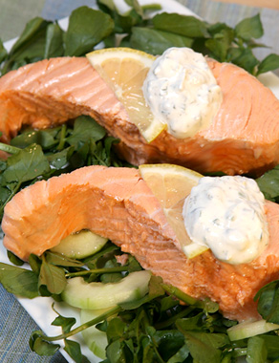
Low in Total Fat and Saturated Fat
3 grams per serving
Seafood preparation can add fat
Sauces
Deep-fat frying
14
Notes:
Low in Total Fat and Saturated Fat (slide 14)
Seafood is low in Total Fat and Saturated Fat. Most fish and shellfish contain less than 5% total fat, and even the fattier fish, such as mackerel and King salmon, have no more than 15% fat. A large proportion of the fat in seafood is polyunsaturated.
Excessive saturated fat contributes to high-caloric diets that promote obesity and have been associated with increased risk of heart disease, certain types of cancer, and possibly gallbladder disease. Seafood generally is considered to be lower in fat than many other animal protein foods. Many species can be labeled “low fat” according to the Food and Drug Administration’s (FDA) criterion, because they contain less than 3 grams of saturated fat per cooked serving (100 grams).
In addition, fish fat is rich in polyunsaturated fatty acids. The type of fat consumed is just as important as the total fat consumed. Seafood can contribute to calorie-controlled weight loss diets, particularly when it replaces high-fat sources of protein.
Typically, it is the way seafood is prepared that adds fat, such as sauces and deep-fat frying, not the fish itself. Cooking techniques such as broiling, barbecuing, poaching, microwaving, or steaming on a rack will help reduce the amount of total fat in the fish recipe. Lesson 4 will discuss cooking methods.
Saturated fat and calorie content differ between fried fish and baked fish.
Instructor: Show an example of 3-ounce portion.

Slide 15
Harvard School of Public Health Study
Research group looked at baked or broiled fish versus fried varieties and the risk of death from various types of heart disease.
Fried was associated with trends toward higher risk of heart disease
Fried fish – 2.8 grams of saturated fat and 195 calories
Baked fish – 1.5 grams of saturated fat and 129 calories
15
Notes:
Harvard School of Public Health Study (slide 15)
Dr. Dariush Mozaffarian from the Harvard School of Public Health stressed that not all methods of cooking fish are created equal. His research group looked at baked or broiled fish versus fried varieties and the risk of death from various types of heart disease in a group of subjects over the age of 65.
Eating tuna or other broiled or baked fish three or more times per week was linked to a 49% lower risk of death from heart disease when compared with those who ate these foods less than once a month. Eating fried fish was associated with a higher risk of dying from heart disease.
The types of fish used for frying, especially in restaurants and fast food eateries, are likely low in omega-3 fats—the fats that seem to offer the most heart-healthy perks. Also, the oils used to fry the fish, especially at the time the study was carried out, would be high in trans fats.

Slide 16
Fat Content
Seafood and Other Protein Foods
3-ounce edible portions, cooked | Total fat (grams) | Saturated fat (grams)
Tuna, light, canned in water, drained, Pollock, broiled, skinless Shrimp, boiled Trout Chicken, light meat, w/out skin, roasted | 1 1 1 3.4 4 | 0 0 0 0.6 1
Salmon, Atlantic/Coho, baked, skinless Chicken, dark meat, w/out skin, roasted Eggs, boiled | 10 8 9 | 2 2 3
Salmon, King Pork loin, lean, roasted | 11 11 | 3 4
Mackerel, Atlantic/Pacific Ground beef, extra lean Hot dog, beef Peanut butter | 13 14 25 44 | 3.7 5 10 7
16
Notes:
Fat Content of Seafood and Other Protein Foods (slide 16)
Most fish and shellfish contain less than 5 grams of total fat. Even the fattiest fish, such as mackerel and king salmon, have no more than 13 grams of total fat per serving.
Lean fish have less fat than other protein-rich foods such as chicken and eggs. Even the fattier fish contain less fat than most ground beef, some processed meats, and the fattiest parts of poultry products.
Look at the color of the raw flesh to get a general idea of the fat content of the fish. Lower-fat species, such as cod, tilapia, and flounder, have a white or light color. Fattier fish, such as salmon, herring, and mackerel, have a much darker color. The fat content of the fish and shellfish varies depending on when and where they were caught and other factors.
Instructor: Show samples of actual product if you wish.

Slide 17
Low-Fat Seafoods
Less than 3 grams total fat per 3-ounce serving
Clams Cod Blue crab Dungeness crab Flounder Grouper Haddock Halibut | Northern lobster Mackerel (King) Mahi-mahi Monkfish Perch (freshwater) Ocean perch Pike (Northern) Walleye Pollock (Atlantic) | Orange roughy Rockfish Scallops Shrimp Red Snapper Snow crab Smelt | Sole Squid Striped bass Tuna (skipjack) Tuna (yellowfin)
17
Notes:
Low-Fat Seafoods (slide 17)
This slide shows the fat content of 3-ounce cooked portions of fish and shellfish—all contain less than 3 grams of total fat. See if you can spot some favorites on this list.

Slide 18
Main Source of Omega-3 Fatty Acids
Fat in seafood is polyunsaturated, including omega-3 fatty acids
Have added health benefits such as healthy brain and eye development in children and reduce the risk of heart disease in adults.
18
Notes:
Main source of Omega-3 fatty acids (slide 18)
A large proportion of the fat in seafood is polyunsaturated, including omega-3 fatty acids, which have added health benefits such as healthy brain and eye development in children and reducing the risk of heart disease in adults.
Moderate evidence shows that consumption of about 8 ounces (cooked, edible portion) per week of a variety of seafood, which provide an average consumption of 250 mg per day of EPA and DHA, is associated with reduced cardiac deaths among individuals with and without pre-existing cardiovascular disease. Thus, this recommendation contributes to the prevention of heart disease. The recommendation is to consume seafood for the total package of benefits that seafood provides, including its EPA and DHA content.

Slide 19
Omega-3 Fatty Acids
Long Chain Polyunsaturated Fatty Acids (LC-PUFAs)
Eicosapentaenoic acid (EPA)
Fatty fish and fish oils
Docosahexaenoic acid (DHA)
Fatty fish, fish oils and algal oil
Alpha-linolenic acid (ALA)
Walnuts, flaxseed oil, soybean oil, and canola oil
19
Notes:
Omega-3 Fatty Acids (slide 19)
Research on the potential benefits of omega-3s has been going on since the early 1970s, when Danish scientists discovered people who eat more fish have a lower risk of heart disease.
Omega-3s are essential fatty acids that are required for healthy human development. These organic compounds are not produced in substantial amounts by the human body and must be obtained from dietary sources.
Omega-3 fatty acids are a family of particularly long-chained polyunsaturated fats. These fats are even more unsaturated than vegetable oil. There are three types of omega-3 fatty acids. Two found mostly in coldwater fish are called eicosapentaenoic acid (EPA) and docosahexaenoic acid (DHA). Fish living in cold water have adapted to have higher levels of omega-3s, so the fat in their tissues stays liquid, almost like antifreeze. The third omega-3 fatty acid is alpha-linolenic acid (ALA). Your body absorbs and uses each type of omega-3 differently. Most potential health benefits are attributed to EPA and DHA, which are readily absorbed and put to use.
Humans can manufacture some types of fatty acids in the body, but must obtain those essential for good health—omega-3s and omega-6s—from the diet. Omega-3s are best found in seafood and plants such as soybean, canola, flaxseed, and purslane. Alpha-linolenic acid occurs in plant sources such as flaxseed, English walnuts, sunflower seeds, canola oil, soy, wheat germ, and dark leafy greens. Omega-6 fats also occur in seafood of all kinds. Plant foods such as sunflower seed, corn, and soybean are usually a better source of omega-6 fats than seafood.
How do omega-3 fatty acids prevent or relieve human disease? Polyunsaturated fats are incorporated into numerous cells of the body and form potent hormone-like substances called eicosanoids. Omega-3 fatty acids help keep our bodies from overproducing eicosanoids, which in large amounts contribute to arthritis, asthma, heart disease, stroke, and related disorders. Eicosanoids are derived from both vegetable and fish oils. The eicosanoids derived from fish oils differ in chemical structure from vegetable-based eicosanoids and usually produce a different effect on the body.
Regular seafood intake plays an important role in achieving a healthy ratio of omega-3 to omega-6 fatty acids. The eicosanoids produced from omega-3 fatty acids are anti-inflammatory, while the eicosanoids produced from omega-6 fatty acids are considered pro-inflammatory. By altering the balance of omega-3 to omega-6 fatty acids in our diets, we can change our eicosanoid production. If diets are high in omega-6 fatty acids, more pro-inflammatory eicosanoids are produced, increasing the risk of heart disease, arthritis, asthma, allergies, and other chronic inflammatory diseases. If you consume more omega-3 fatty acids, not only will you produce more anti-inflammatory eicosanoids, but you will also displace some of the pro-inflammatory compounds created by omega-6 fatty acids.

Slide 20
Omega-3s and Recommended Servings
Daily intake of 496 mg EPA and DHA is equivalent to about 3.5 grams per week
This is equivalent to the amount of EPA and DHA in two 4-ounce servings of high omega-3 fish per week
Based on an average EPA and DHA content of high omega-3 fish of 1.6 grams per serving
Rationale for 2 servings of high omega-3 fish per week
20
Notes:
Connection between Omega-3s and Recommended Servings Per Week (slide 20)
Instructor: Share the handout “EPA and DHA in Seafood.”
A daily intake of 496 milligrams of EPA and DHA is equivalent to about 3.5 grams per week.
This is approximately equivalent to the amount of EPA and DHA in two 4-ounce servings of high omega-3 fish per week, based on an average EPA and DHA content in high omega-3 fish of 1.6 grams per serving.

Slide 21
Omega-3 Fat Content
Higher level (more than 1.0 gram per cooked serving)
Herring | Mackerel (Spanish) |  | Salmon (king) | Tuna (bluefin)
Mackerel (Pacific and jack) | Salmon (Atlantic) |  | Salmon (pink) | Rainbow trout
Medium level (between 0.5 and 1.0 gram per cooked serving)
Fish
Bass (freshwater) | Bluefish |  | Mackerel (Atlantic) | Salmon (sockeye)
Salmon (chum) | Salmon (coho) |  | Smelt | Striped bass
Swordfish | Whiting
Shellfish
Blue mussels |  | Oysters
21
Notes:
Omega-3 Fat Content (slide 21)
All fish contain beneficial amounts of omega-3 fatty acids, but oily or fatty fish have more omega-3 fatty acids than leaner fish. An average oily fish provides 2 grams of omega-3 fatty acids per 100-gram (3.5 oz.) raw portion, whereas an average lean fish provides only 0.3 gram per 100-gram (3.5 oz.) raw portion. Oily fish include rainbow trout, sardines, pilchards, mackerel, herring, and salmon.
Instructor: Refer to EPA and DHA handout already passed out.

Slide 22
Omega-3 Fat Content
Lower level (0.5 grams and less per serving)
Fish |  |  | Shellfish
Cod (Atlantic) | Ocean perch |  | Clams
Flounder | Pike (Northern) |  | Blue crab
Grouper | Pollock (Atlantic) |  | Dungeness crab
Haddock | Rockfish (Pacific) |  | Snow crab
Halibut | Red snapper |  | Northern Lobster
Mahi-mahi | Sea trout |  | Spiny lobster
Tilapia | Tuna (skipjack) |  | Scallops
Freshwater perch | Tuna (yellowfin) |  | Shrimp
Note: All fish and shellfish were cooked by dry (baking, broiling, or microwaving) or moist (boiling, poaching, or steaming) cooking methods.
22
Notes:
Omega-3 Fat Content (slide 22)
This slide shows seafood with the lower levels of omega-3s.
The average fish has about 3 grams of total fat per 100 grams. To prevent essential fatty acid deficiency, nutritionists generally recommend humans eat at least 2.4% of total fat intake as omega-6 fats and 0.5% to 1.0% of total fat as omega-3 fats.

Slide 23
Cholesterol Content
Most fish and shellfish contain fewer than 100 milligrams of cholesterol per 3-ounce cooked serving
Many leaner types of fish have fewer than 50 milligrams per serving
“Lobster Dish” by Dhi
23
Notes:
Cholesterol Content (slide 23)
As part of a healthy diet, the USDA has suggested in their dietary guidelines that Americans limit the amount of cholesterol in their diet. Both fish and shellfish are naturally low in cholesterol and can help keep your daily consumption of cholesterol below the recommended 300 milligrams per day.
Diets high in cholesterol may contribute to high blood cholesterol levels, thus increasing the risk of heart disease and stroke. Many Americans consume too much cholesterol. Current dietary recommendations suggest reducing cholesterol intake to less than 300 milligrams per day.
Most animal foods, including seafood, contain cholesterol, but almost all fish and shellfish contain well under 100 milligrams of cholesterol per 3-ounce cooked serving. Many leaner types of fish have less than 60 milligrams per serving.
In the past it was thought shellfish were much higher in cholesterol, but recently new analytical techniques have identified most of what was thought to be cholesterol was actually other forms of sterols.

Slide 24
Cholesterol Content
Seafood and Other Protein Foods
Seafood *3-ounce edible portions, cooked | Cholesterol (mg)
Peanut butter | 0
Orange roughy | 20
Halibut | 35
Cod | 45
Tuna, light, canned in water drained | 45
Salmon, Atlantic, baked, skinless | 50
Trout | 58
Chicken, dark and light meat, w/out skin, roasted | 64
Ground beef, extra lean | 70
Pork loin, lean, roasted | 77
Pollock, broiled, skinless | 80
Hot dog, beef | 86
Shrimp, boiled | 165
Eggs, boiled | 362
24
Notes:
Cholesterol Content of Seafood and Other Protein Foods (slide 24)
This chart shows the cholesterol contents of seafood and other protein foods. Refer to the handout “Seafood Nutrition Facts” for more information on the cholesterol contents of various seafoods.

Slide 25
Omega-3s and the Heart
Three processes influence development and progression of heart disease
Atherosclerosis
Omega-3s lower triglyceride levels
Clot Formation
Omega-3s reduce the stickiness of platelets
Blood Vessel Spasms
Omega-3s help relax blood vessel walls
25
Notes:
Omega-3s and the Heart (slide 25)
Three major processes influence the development and progression of heart disease—atherosclerosis, clot formation, and blood vessel spasms. Omega-3 fatty acids produce positive effects on each of these three processes.
In atherosclerosis, the arteries narrow due to fat deposits that accumulate on the inside of the artery wall. The result is reduced blood flow to the heart, brain, and other vital organs. Omega-3 fatty acids significantly lower triglycerides, fats circulating in the blood. Studies also show the omega-3 fatty acids may slow down the rate at which coronary arteries close following the mechanical opening of the artery (angioplasty).
A clot can form and block an artery. This clot is developed from a clump of aggregated platelets and associated materials. Omega-3s may reduce the “stickiness” of platelets, inhibiting clot formation. More flexible blood cells flow more smoothly and slide through closing arteries.
Decreased blood flow also can produce spasms of the muscle surrounding the blood vessel. A spasm causes the blood vessel to constrict, further limiting blood flow. Omega-3s help relax blood vessel walls and help them to stay elastic.

Slide 26
Omega-3s and the Heart
Omega-3s stabilize each individual heart muscle cell so during a heart attack arrhythmia is less likely
Omega-3s reduce the risk of dying from heart disease
Consistent evidence supporting risk reduction of CVD due to fish consumption
26
Notes:
Omega-3s and the Heart (slide 26)
In 2006, Harvard researchers determined that eating 250 milligrams a day of EPA and DHA from either fish or fish oil supplements helped reduce the risk of dying from a heart attack by 36%. Omega-3s stabilize each individual heart muscle cell so that during a heart attack it is less likely to beat out of rhythm, which is called arrhythmia. This can be fatal because it impairs the heart’s ability to pump blood throughout the body.
Research continues to confirm that eating seafood twice a week is the best advice for good health.
There is consistent evidence supporting risk reduction of CV.
Remember, the quality of fish that you consume is important. Lesson 4 will address the difference between fried fish and baked fish or fish with lots of breading and deep fat fried as opposed to a plain fillet prepared at home.

Slide 27
Other Benefits of Omega-3 Fatty Acids
Joints Fewer tender joints and decreased stiffness
Mood Higher levels of EPA and DHA protective against depression
Mind Inflammation in the center of the brain may play a role in Alzheimer’s disease
Lungs May decrease severity of asthma
27
Notes:
Other Benefits of Omega-3 Fatty Acids (slide 27)
Omega-3 fatty acids act at the synovium, a one-cell-thick layer of tissue that encapsulates joints and feeds nutrients to cartilage. Omega-3s decrease the production of inflammatory proteins called cytokines. Cytokines play a role in stripping cartilage and eroding the bone. While omega-3s have not been proven to stop the progression of rheumatoid arthritis, researchers have found those who consume EPA and DHA have fewer tender joints and decreased stiffness.
Studies in which scientists compared fish intake across several countries have concluded rates of clinical depression, bipolar disorder, and postpartum depression are nearly 30 to 50 times greater in countries having low fish consumption. Omega-3s may offer mood-enhancing effects even in those who aren’t diagnosed with mental illness. Researchers have observed that people having higher levels of EPA and DHA were less likely to report feeling blue, even when measured against a normative range of depressive symptoms. EPA and DHA may improve brain cell composition and neurotransmitter function, which is dysfunctional in people who are clinically depressed.
Studies are showing people who eat fish two to three times a week are about half as likely to experience age-related cognitive decline, including Alzheimer’s disease. Experts believe inflammation in the memory center of the brain may play a role in Alzheimer’s disease. Excessive plaque builds up in Alzheimer’s patients. As a result, brain cells die. Reducing the inflammatory status may help prevent progression of the disease. Omega-3s produce more anti-inflammatory eicosanoids.
Some evidence indicates omega-3s may help decrease the severity of asthma. Asthma is caused by inflammation in the airways, and omega-3s may help suppress that inflammation.

Slide 28
Omega-3s and Diabetes
Onset of diabetes
May keep the immune system in check
Control of symptoms
Low level of DHA associated with increased insulin resistance
Complications of diabetes
Influence development of cardiovascular disease
May delay onset of kidney and nerve complications
28
Notes:
Omega-3s and Diabetes (slide 28)
Diabetes is a chronic disease in which the body is either unable to produce insulin or incapable of using insulin effectively. In the onset of diabetes, omega-3s may keep the immune system in check, reducing the likelihood the body’s insulin-producing cells will self-destruct.
In noninsulin-dependent (type II) diabetes, a low level of DHA is associated with increased insulin resistance. The body is able to produce sufficient insulin, but the tissue is resistant to insulin activity. Regular consumption of a diet high in omega-3 fatty acids may help control blood sugar in these cases.
As for the complications of diabetes, omega-3s may help to slow the development and progression of cardiovascular disease, the most common and serious complication of diabetes. Omega-3 fatty acids may also delay the onset of kidney and nerve complications or may control their progression.
Diabetes and heart disease management require a combined strategy. Omega-3s have a favorable effect on heart disease risk factors such as platelet aggregation (responsible for the stickiness of the blood), high blood pressure, and metabolism of plasma lipoproteins (blood fats). Omega-3 fatty acids change the critical balance of lipoproteins, thus reducing the low-density lipoproteins (LDL) and the very low density lipoproteins (VLDL) that deposit cholesterol along the artery wall. The omega-3 fatty acids also lower the levels of blood triglycerides, another type of fat involved in heart disease.
People who have diabetes need to be careful when supplementing with omega-3 fish oil capsules, which may result in increased levels of blood sugar.
Researchers continue to look at the possible role of omega-3 fatty acids in the prevention and control of diabetes.

Slide 29
Omega-3s and Cancer
Onset
May help healthy cells resist damage
Multiplication
May interfere with tumor growth
Spread
May inhibit tumor spread in the body
29
Notes:
Omega-3s and Cancer (slide 29)
Cancer is the second most common cause of death in the U.S.—second only to heart disease. Cancer refers to a group of diseases in which body cells multiply and spread uncontrollably. Most of the research on omega-3 fatty acids and cancer has been done in animal studies. Some recent studies have been done in humans. Although the research is incomplete, there is a strong suspicion omega-3 fatty acids may play a protective role in each stage of cancer development.
At the onset of cancer, damage of cellular DNA allows initiation of tumor cells. If the damage is repaired before the cell multiplies, no tumor will occur. Omega-3 fatty acids may help unhealthy cells resist damage by tumor-producing cells. More studies are being done on how omega-3s help unhealthy cells.
During the multiplication of cells, when the cell with damaged DNA reproduces, it duplicates the damage. If unchecked, the multiplying cells can develop into a tumor. Omega-3 fatty acids may interfere with tumor growth.
When cancer cells spread, the tumors can then keep growing and invade vulnerable tissues. Omega-3s may inhibit the spread of the tumor throughout the body.

Slide 30
Omega-3s in Pregnancy and Infancy
Omega-3s and the last trimester of pregnancy
Rapid synthesis of brain tissue
Omega-3s and premature infants
Risk factor for preterm delivery and low birth weight
Omega-3s and the newborn
DHA is influenced by the mother’s diet
30
Notes:
Omega-3s in Pregnancy and Infancy (slide 30)
Omega-3s are essential for early human development. During pregnancy the fetal brain, nervous system, and eye tissues accumulate docosahexaenoic (DHA), one of the omega-3 fatty acids. Essential fatty acids, particularly DHA, are needed for cell membranes. DHA comprises approximately 40% of the polyunsaturated fatty acid content in the cell membranes in the brain and 60% of the cell membranes in the retina. It is transferred from the mother to the fetus at a high rate during the last trimester of pregnancy. It is evident from a number of studies that an adequate supply of DHA is needed for brain growth and functional development of infants. DHA levels depend upon the mother’s diet during pregnancy.
The requirement for omega-3 fatty acids in pregnancy has not been established. However, a pregnant woman can provide her developing fetus with significant DHA by eating seafood twice a week.
Infants born before 32 weeks gestation have lower body supplies of DHA. These infants can catch up if they are fed breast milk or a formula supplemented with DHA.
During the first 3 months of life, DHA concentrations increase three to five times. DHA accumulation in the brain continues through the first 2 years of life. Human milk is the only infant food that provides significant and available forms of omega-3 fatty acids. The DHA content of breast milk is greatly influenced by the mother’s diet. Women who consume seafood have more DHA in their breast milk.
Breastfed infants have a higher DHA level in the brain and red blood cells. They are likely to have enhanced neural development compared with formula-fed infants. One study indicates infants need a continuous supply of DHA. Infants breastfed for a shorter period (less than 16 weeks), show poorer visual acuity scores than those receiving DHA, either from breast milk or fish oil.
A study published in the July 2004 edition of the Journal of Epidemiology assessed the fish intake of more than 7,400 mothers in the United Kingdom. It found those who ate fish regularly during pregnancy had children showing better language and communication skills by the age of 18 months.
Other research has backed up a connection between omega-3s and attention deficit hyperactivity disorder (ADHD). A study first reported in 1995 linked ADHD to a deficiency of omega-3. Children deficient in omega-3 oils may be more likely to have behavioral and learning problems, such as ADHD.

Slide 31
Sodium Content
Fish low in sodium
Fewer than 110 milligrams per 3-ounce cooked portion
Shellfish usually contain more sodium
“Grilled Trout at Avo” by Ralph Daily
31
Notes:
Sodium Content (slide 31)
The U.S. FDA and the Institute of Medicine suggest lowering sodium intake in the diet for better health. In 2010, the U.S. Dietary Guidelines Advisory Committee lowered the suggested daily intake of sodium from 2300 milligrams per day to 1500 milligrams per day. Sodium has been identified as a nutrient that we need to reduce in our diets.
Excessive sodium consumption has been linked to high blood pressure (hypertension), which is a risk factor for heart attacks and stroke.
Sodium in raw seafood is naturally low, but can increase rapidly during processing and preparation. Processed foods that have higher levels of sodium include those that are canned, smoked/dried, and kippered. Even the species having the highest sodium levels contain less than 110 milligrams per 3-ounce cooked portion, which is less than 5% of the daily recommended maximum sodium intake of 2,400 milligrams. Shellfish usually contain more sodium, approximately 200-330 milligrams per 3-ounce cooked serving.
For lower sodium and fat counts, purchase water-packed varieties of canned fish such as salmon or tuna instead of those packed in oil. Then rinse them well. Check the label; many times sodium is added to cans of seafood, and oil will add fat. Refer to “Seafood Nutrition Facts” for more information.

Slide 32
Vitamin Content
Source of B complex vitamins
Niacin, B12 and B6, thiamin
Vitamin D in fattier fish
“Clam Chowder” by Jen
32
Notes:
Vitamin Content (slide 32)
Seafood is a natural source of B-complex vitamins, vitamin D and vitamin A (especially in oily fish). The amount of B vitamins in most fish and shellfish is about the same as in many other high-protein foods.
Niacin helps growth and development and helps maintain our nervous system and gastrointestinal tract. Fish is a good source of niacin.
Vitamin B12 helps form red blood cells and maintains nerve and gastrointestinal tissues. Fish is a good source of vitamin B12.
Vitamin B6 promotes production of antibodies and red blood cells. Fish is a good source of vitamin B6.
Thiamin is present in seafood in fair amounts. Thiamin promotes normal growth and appetite and releases energy from carbohydrates.
There are two types of vitamins, fat soluble (A, D, E, and K) and water soluble (C and the B complex). The fat-soluble vitamins A and D are found in fish liver oils and in small amounts in the fatty tissues of fish. Some of the fattier fish like mackerel and herring can be a good source of vitamin D and some fatty fish like sardines can provide a reasonable amount of vitamin D, but most fish are not considered to be a particularly good source of fat-soluble vitamins. Seafood generally is low in fat, and we usually don’t consume fish liver oils; therefore, seafood is not considered a significant source of the fat-soluble vitamins.
Little vitamin C is found in seafood.

Slide 33
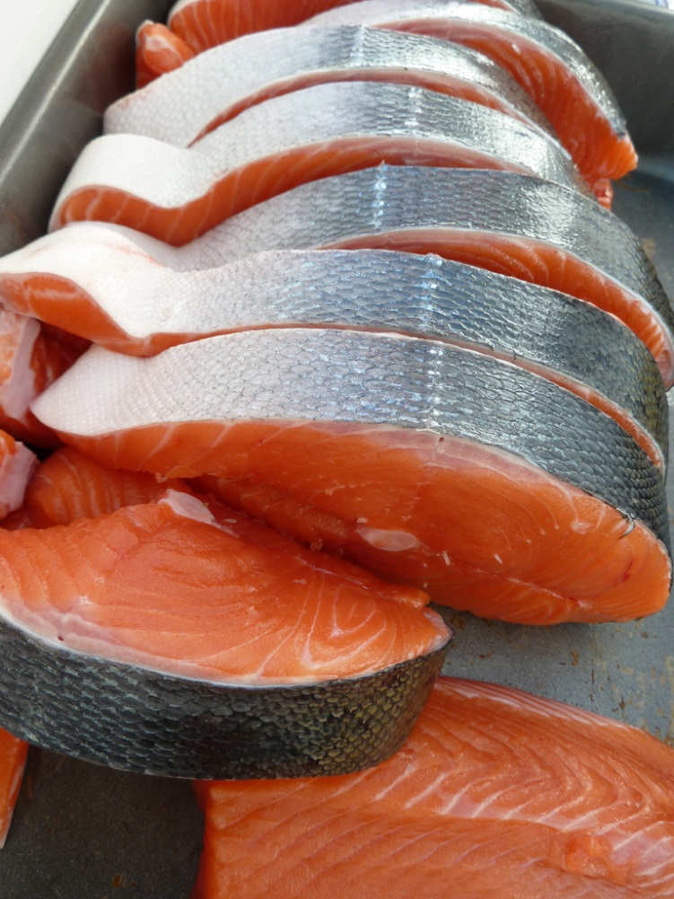
Minerals
Calcium
Iron
Zinc
Copper
Potassium
Iodine
Phosphorus
Selenium
Magnesium
“Fish Steaks” by Jill Siegrist
33
Notes:
Minerals (slide 33)
Seafood is an excellent source of minerals. Dietary intakes of several nutrients – potassium and calcium are low enough to be of public health concern for both adults and children.
Fish are one of the most important sources of calcium. The soft bones of small fish such as sardines and smelt and canned varieties such as salmon are especially valuable sources of calcium, providing 180 to 320 milligrams (mg) per 3-ounce serving (when the bones are eaten):
sardines 325 mg
pink salmon 181 mg
perch 116 mg
clams 78 mg
rainbow trout 73 mg
Other minerals per 3-ounce serving include:
Iron–canned clams, 23.8 mg; oysters, 10.2 mg; shrimp, 2.3 mg; also bluefish and shrimp
Zinc–oysters are a great source of iron and zinc, which are needed for strong and healthy nails (also, crustaceans)
Copper–oysters, crabs, and lobster
Potassium–clams, 534 mg; halibut, 490 mg; tuna, 484 mg; cod, 439 mg; also mussels, scallops
Iodine, phosphorus, and selenium–all seafood in general
Selenium works as a potent antioxidant with vitamin E. Selenium is now recognized as an essential element for humans. It plays a major role in the enzymes that make up part of the body’s antioxidant defense and other systems. It helps prevent DNA damage caused by various chemicals and radiation. The antioxidant properties help prevent cellular damage from free radicals.
Selenium may be a more important player than previously thought. It has been shown to counter the effects of mercury, possibly making it less toxic. If a woman is short of selenium and is exposed to mercury, it’s not healthy.
Phosphorus helps build bones and teeth, helps release energy from food, and regulates energy metabolism.
Iodine is a component of two thyroid hormones that regulate the rate at which our bodies use energy.
Magnesium is used in building bones, manufacturing proteins, regulating energy from muscle storage, and regulating body temperature.

Slide 34
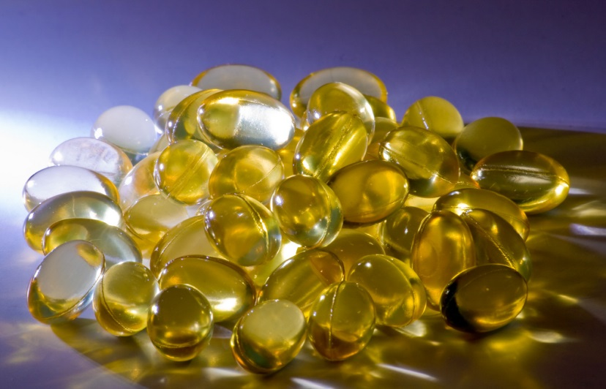
Fish or Fish Oil Supplements?
Seafood preferred to fish oil supplements
Raise concerns for people with diabetes
Bleeding disorders
Cancer treatments
Always consult your physician
“Fish Oil Supplements” by Hit Thatswitch
34
Notes:
Fish or Fish Oil Supplements? (slide 34)
The fundamental premise of the Dietary Guidelines is that nutrients should come primarily from foods. Americans should aim to meet their nutrient requirements through a healthy eating pattern that includes nutrient-dense forms of foods, while balancing calorie intake with energy expenditure. Seafood in general is preferred to fish oil supplements. Where larger amounts of omega-3 fatty acids are needed and finfish intake is a problem, fish oil can play a valuable health role.
Although fish oil supplements can provide a hefty dose of omega-3s, they raise serious concerns for some people, including diabetics. People with diabetes should exercise caution in supplementing with omega-3 fish oil capsules (where 1 gram of fish oil is about 30% omega-3 fatty acids). Dosages between 4 and 10 grams per day (equivalent to one to three servings of seafood per day) may result in increased levels of blood sugar (glucose). Lower doses (2.5 grams per day) have been shown not to affect glycemic control, yet they still provide useful protection against heart disease risk factors.
Individuals who have bleeding disorders or are taking blood-thinning medications (such as aspirin) daily should not use fish oil supplements because they decrease the ability of blood to clot. Those undergoing cancer treatment should ask their doctor’s approval before taking fish oil or any other dietary supplements.
Remember the basic premise of the Dietary Guidelines is that nutrient needs should be met primarily through foods. And always consult your physician before taking supplements.

Slide 35
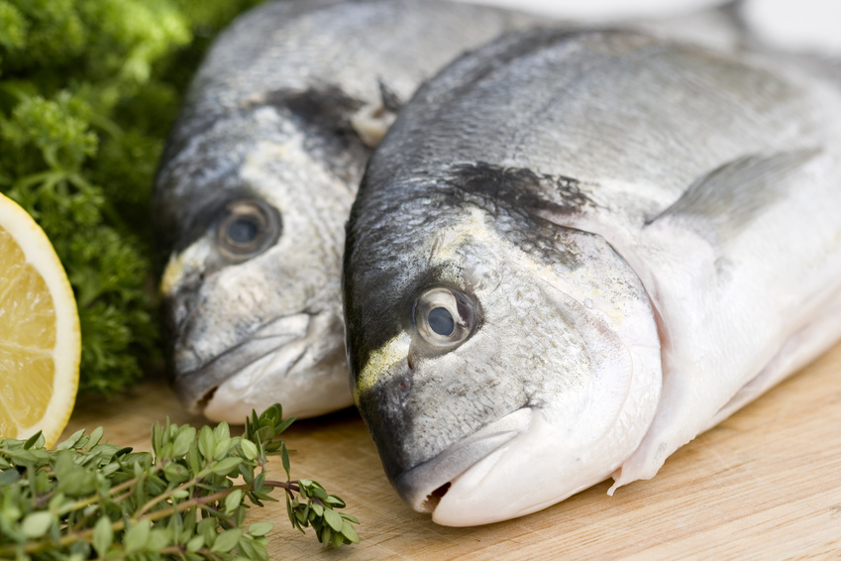
The Dietary Guidelines for Americans 2010…
Includes a new quantitative recommendation for seafood intake
Intake of two servings per week
35
Notes:
The Dietary Guidelines for Americans 2010 (slide 35)
The Dietary Guidelines for Americans 2010 includes a new quantitative recommendation for seafood intake. An intake of 8 or more ounces per week (less for young children) about 20% of total recommendation intake of protein foods of a variety of seafood is recommended.
The American Heart Association recommends eating fish (particularly fatty fish) at least two times (two servings) a week. Each serving is 3.5 ounce cooked, or about ¾ cup of flaked fish.
Omega-3 fatty acids benefit the hearts of healthy people and the hearts of people who either have cardiovascular disease or are at high risk of developing it.

Slide 36
Summary
The 2010 Dietary Guidelines for Americans recommends all adults eat fish twice a week
Most fish and shellfish contain under 100 mg of cholesterol per 3-ounce serving
Seafood is considered the best dietary source of omega-3 fatty acids
36
Notes:
Summary (slide 36)
The 2010 Dietary Guidelines for Americans recommends all adults eat fish twice a week.
Almost all fish and shellfish contain well under 100 milligrams of cholesterol per 3-ounce cooked serving.
Seafood is the best source of omega-3 fatty acids. Salmon, trout, and herring are all rich in omega-3s.

Slide 37
Summary
Many species of seafood contain fewer than 3 grams of fat per serving
Seafood is low in sodium
Fish is a good source of vitamins B6 and B12
Seafood is an excellent source of minerals
37
Notes:
Summary (slide 37)
Many species of seafood can be labeled “low fat” because they contain fewer than 3 grams of fat per serving.
A 3-ounce cooked portion of most seafood contains fewer than 110 milligrams of sodium.
Fish is a good source of vitamins B6 and B12.
Seafood is an excellent source of minerals.

Slide 38
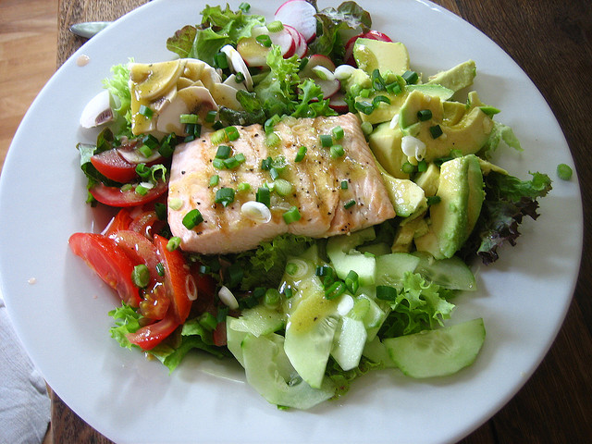
Why Aren’t You Eating Fish?
Moderate evidence shows that the health benefits from consuming a variety of seafood in the amounts recommended outweigh the health risks associated with methyl mercury
“Salmon Salad” by Jeremy Keith
38
Notes:
Why Aren’t You Eating Fish? (slide 38)
The Institute of Medicine, the World Health Organization, the 2010 Dietary Guidelines for Americans, the National Heart Lung Blood Institute (NHLBI), the National Cholesterol Education Program (NCEP), and countries around the world all recommend increased fish consumption.
The question should be: Why aren’t you eating seafood? Moderate, consistent evidence shows that the health benefits from consuming a variety of seafood in the amounts recommended outweigh the health risks associated with methyl mercury.
Instructor: Refer to the handout on recommendations for seafood and EPA/DHA consumption.

Slide 39
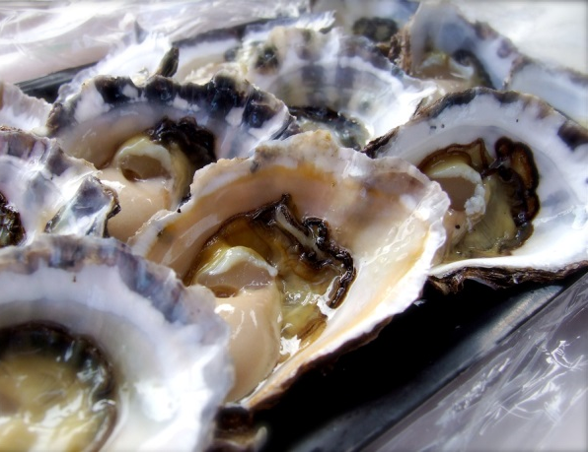
Seafood – at Its Best
“Do Your Health a Favor – Eat Seafood”
“Blackened Teriyaki Salmon…” by Blue Moon in Her Eyes
“Fish Market Mahi Mahi Sandwich by Mr. T in DC
Photo: Blue Moon in Her Eyes
“Chili Lime Shrimp” by Mike McCune
39
“Harissa Salmon…” by Blue Moon in Her Eyes
“Shellfish Risotto” by Sarah Braun
“Yummy Oysters…” by Free Range Jace
Notes:
Do Your Health a Favor—Eat Seafood! (slide 39)
In general, seafood is one of the most nutritionally balanced foods. Seafood is a high-protein food that is low in calories, total fat and saturated fat. It is high in vitamins and minerals, and has been shown to have numerous health benefits. It reduces the risk of cardiac disease for the general population and provides essential nutrients during fetal growth and development. Based on evidence of these health benefits, the 2010 Dietary Guidelines for Americans include a new quantitative recommendation for seafood intake. The Guidelines recommend that consumers eat at least 8 ounces of seafood each week and that women who are pregnant or breastfeeding eat 8 to 12 ounces of seafood per week. Three to six ounces per week is recommended for children. Seafood is a delicious way to accomplish heart-healthy eating habits.
What’s for dinner tonight at your house?
Now, let’s take a few minutes to complete the posttest.
Instructor: Pass out the posttest.

Slide 40
Photo credits | licensed under Creative Commons
“Seafood Platter” by Tom O’Malley – CC BY 2.0
“Colorful Eggs” by Andy Melton – CC BY-SA 2.0
“Nutty Browns” by Nomadic Lass – CC BY-SA 2.0
“Black & White Bean Salad” by Cookbookman17 – CC BY 2.0
“Met Scallops” by Ralph Daily – CC BY 2.0
“Roast Chook with Chicken Liver & Rosemary Stuffing” by Jules – CC BY 2.0
“Filet Mignon” by Neeta Lind – CC BY 2.0
“Sesame Crusted Ahi Tuna…” by Ralph Daily – CC BY 2.0
“Cod en Papillote w/Lemon and Thyme on Leeks and Carrots” by Anjuli Ayer – CC BY-NC 2.0
“Lobster Dish” by Dhi – CC BY 2.0
“Grilled Trout at Avo” by Ralph Daily – CC BY 2.0
“Clam Chowder” by Jen – CC BY 2.0
“Fish Steaks” by Jill Siegrist – CC BY-NC-SA 2.0
“Fish Oil Supplements” by Hit Thatswitch – CC BY-NC-SA 2.0
“Salmon Salad” by Jeremy Keith – CC BY 2.0
“Fish Market Mahi Mahi Sandwich by Mr. T in DC – CC BY-ND 2.0
“Blackened Teriyaki Salmon with Watercress and Soba Noodles” by Blue Moon in Her Eyes – CC BY-NC-SA 2.0
“Chili Lime Shrimp” by Mike McCune – CC BY 2.0
“Harissa Salmon with Pistachio Salt and Couscous Salad” by Blue Moon in Her Eyes – CC BY-NC-SA 2.0
“Shellfish Risotto” by Sarah Braun – CC BY-NC-SA 2.0
“Yummy Oysters @ Big Oyster, Port Macquarie, NSW” by Free Range Jace – CC BY-NC-SA 2.0
Notes:
Photo credits | The following are licensed under Creative Commons:
Slide 2:
“Seafood Platter” by Tom O’Malley - CC BY 2.0 /cropped from original
Slide 10:
“Colorful Eggs” by Andy Melton – CC BY-SA 2.0
“Nutty Browns” by Nomadic Lass – CC BY-SA 2.0 / rotated from original
“Black & White Bean Salad” by Cookbookman17 – CC BY 2.0 / cropped and rotated from original
“Met Scallops” by Ralph Daily – CC BY 2.0
“Roast Chook with Chicken Liver & Rosemary Stuffing” by Jules – CC BY 2.0 / cropped from original
“Filet Mignon” by Neeta Lind – CC BY 2.0 / cropped from original
Slide 11:
“Sesame Crusted Ahi Tuna…” by Ralph Daily – CC BY 2.0
Slide 12:
“Cod en Papillote w/Lemon and Thyme on Leeks and Carrots” by Anjuli Ayer – CC BY-NC 2.0 / cropped from original
Slide 23:
“Lobster Dish” by Dhi – CC BY 2.0
Slide 31:
“Grilled Trout at Avo” by Ralph Daily – CC BY 2.0
Slide 32:
“Clam Chowder” by Jen – CC BY 2.0
Slide 33:
“Fish Steaks” by Jill Siegrist – CC BY-NC-SA 2.0
Slide 34:
“Fish Oil Supplements” by Hit Thatswitch – CC BY-NC-SA 2.0
Slide 38:
“Salmon Salad” by Jeremy Keith – CC BY 2.0
Slide 39:
“Fish Market Mahi Mahi Sandwich by Mr. T in DC – CC BY-ND 2.0
“Blackened Teriyaki Salmon with Watercress and Soba Noodles” by Blue Moon in Her Eyes – CC BY-NC-SA 2.0
“Chili Lime Shrimp” by Mike McCune – CC BY 2.0
“Harissa Salmon with Pistachio Salt and Couscous Salad” by Blue Moon in Her Eyes – CC BY-NC-SA 2.0
“Shellfish Risotto” by Sarah Braun – CC BY-NC-SA 2.0
“Yummy Oysters @ Big Oyster, Port Macquarie, NSW” by Free Range Jace – CC BY-NC-SA 2.0

