Slide 1
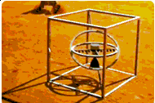
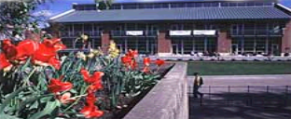
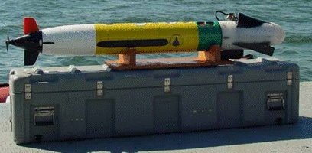
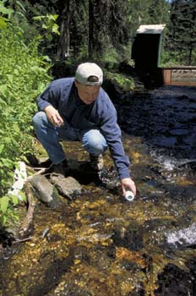
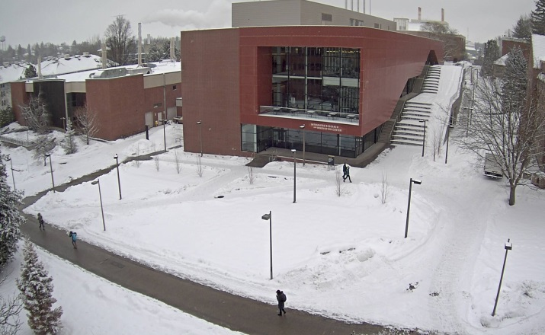
Asset Management
Notes:
Welcome to Asset Management and Accounting.

Slide 2
Property Management Office
Asset Management
Annual Inventory
Verification of Inventory
Property Additions
Property Deletions
Federally Sponsored Grants & Contracts

Slide 3
Annual Inventory
Asset Management
Pursuant to Idaho State Board of Education and Board of Regents of the University of Idaho policy section V.I.4.a.
The University of Idaho must follow Idaho state code Section 67-5746, which requires a physical inventory of all property in the University inventory system once each fiscal year.

Slide 4
Asset Management
Annual Inventory
Each department is responsible for complying and conducting an annual inventory of assets.
Asset Management Office will provide instructions for obtaining and completing the annual inventory by August 31st of each year.
Electronic “Certificate of Inventory Completion” must be returned to Asset Management by the last week of October (or negotiated time frame).

Slide 5
Asset Management
Annual Inventory
Inventory changes must be entered in Vandal Web Asset Change Requests for approvals.
“ODDBALL” discrepancies that cannot be entered in Asset Change can be processed directly with Asset Management
New tags are assigned a “default” location if the actual location is unknown. ALL “default” locations must be changed to the ACTUAL location as soon as possible (within 14 days of receipt) or during annual inventory if this was not accomplished.

Slide 6
Annual Inventory vs Verification of Assets
Annual Inventory is required by the State of Idaho
Verification of assets can be required by the Federal Government, Office of Sponsored Programs, and/or Asset Management depending on the type of Verification being performed.

Slide 7
Asset Management
Annual Inventory
Good Inventory Practices
Affix University property tags within 14 days of receipt.
Promptly enter all changes with locations, user status, and conditions in Vandal Web Asset Change Requests for approval.
Transfer property designated for Facilities Surplus in a timely manner. Enter transfers to Surplus Property in Vandal Web Asset Change/Surplus Transfer Requests for approval (Tagged Equipment)

Slide 8
Asset Management
Verification of Assets
Asset Management Office
Can conduct a physical verification of inventories as a process of evaluating unit inventory effectiveness.
Federal Statute require all federally funded capital assets to be physically verified every two years.
Conducted to verify the accuracy of records in the Banner Fixed Assets.
Verifies the existence and activity status of equipment.
Provides an overall assessment of the effectiveness of the University’s Asset Management Processes.
Measure the level of compliance with established policies and procedures.
Data used in various other management reports

Slide 9
Asset Management
Verification of Assets
Property Management Office
Sampling techniques may include:
Required (Mandated)
Statistical
Stratified
Judgmental
Purposeful
Other sampling methods

Slide 10
Asset Management
Verification of Annual Inventory
Property Management Office
Inventory Verification findings and Reporting:
Asset Management will post results of physical verifications to Banner Fixed Assets and report results to appropriate personnel.
Asset Management will analyze the results and determine if corrective actions are required.
Asset Management will assist UPA in order to implement corrective actions.
May conduct additional verifications to evaluate the effectiveness of proposed changes.

Slide 11
Asset Management
Verification of Annual Inventory
Property Management Office
Report of results distribution:
Unit Property Administrator (UPA)
Dean or equivalent unit Administrator
General Accounting Manager
University of Idaho Controller (where applicable)
Office of Sponsored Programs (where applicable)
Risk Management (where applicable)

Slide 12
Asset Management
Property Additions
Property Additions
Asset Management will review all capital outlay equipment purchases Greater than $5K (account code E6***). Less than $5K (account code E7***)
Asset Management will assign University property tags for each item added to Fixed Assets.
UPA’s and/or end users are responsible for affixing tags to assigned equipment.

Slide 13
Asset Management
Property Additions
Property Additions
UPA must review attached property management inventory sheet (PMIR) and promptly enter all changes in Vandal Web – Asset Change Requests for approval.
UPA must notify Asset Management of items received other than Capital Outlay (CO) (Gifts, Govt furnished property).
Equipment purchases must be assigned correct account code – see above

Slide 14
Asset Management
Property Additions
Property Additions/Deletions
Trade-Ins:
Trade-ins require special care.
Purchase text must include the University Property tag number; Make; Model; Serial/VIN and credit for equipment being traded.
Grant/Contract funded equipment requires prior OSP approval.
Returned to Vendor (Warranty Issues, etc…)
Credit Memo’s must be processed through Accounts Payable and Office of Sponsored Programs (when applicable)
Please notify Asset Management Office immediately

Slide 15
Leased Equipment
General Accounting is now the central location for lease analysis and accounting.
All leases of equipment that would otherwise have a purchase price of $5,000 or more need to be funneled through this office to be properly analyzed to determine if they are capital or operating leases.
The assumption cannot be made that a lease is automatically an operating lease just because it is a copier or similar equipment - there are very specific accounting rules that need to be applied before that determination can be made.

Slide 16
Asset Management
Property Additions

Slide 17
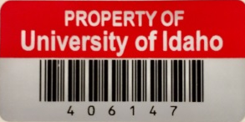
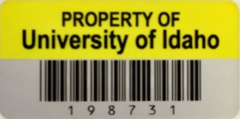
Asset Management
Property Additions
Asset Management Office provides a unique property number for all items included in the fixed assets inventory system that exceed $2K purchase costs.
Capital Assets included exceed $5K.
Red Tags identify Grant Funded equipment
Yellow Tags for all other items. (excluding vehicles)
The tag number for licensed vehicles begins with a “V”, and trailers with a “T”. The plate numbers assigned will show in Banner Fixed Assets and inventory listings.

Slide 18
Asset Management
Property Deletions
Surplus Property
University property may only be disposed as outlined under Surplus Property Inventory & Disposal procedures
See APM 10.41
Computers
Computers cannot be given or sold to employees by a department. Hard drives must be wiped and destroyed through ITS or Surplus Property

Slide 19
Asset Management
Property Deletions
Property Deletions
Deletion Categories:
Lost (Details)
Destroyed (Details)
Scrapped (NO EXCEPTIONS – Surplus Approval)
Cannibalized
Transferred (Will require appropriate approvals)
Returned to lender (Grants)
Returned to vendor (Copiers, Warranty returns)
Traded (Vehicles, Copiers, etc… PURCHASE doc text)
Stolen (requires a Police Report)
Surplus (Asset Change/Surplus Transfer Portal – Vandal Web)

Slide 20
Asset Management
Property Deletions
Property Deletions
University inventory system does allow for depreciation.
However:
Items cannot be removed from inventory simply because estimated value has depreciated less than $2K
Such items will be removed accordingly when properly disposed at Surplus Property

Slide 21
Asset Management
Property Deletions
Property Deletions
Department individuals should remove property tags when:
Returned to Vendor
- Request replacement tag from PMO
Trade-In towards another purchase
Returned to sponsor/lender

Slide 22
Asset Management
Federally Sponsored Grants & Contracts
Federally Sponsored Grants and Contracts (APM 1040 C-7, iv or asset web page link)
Items purchased in whole or in part with funds from federally sponsored grants and contracts or government furnished property generally require adherence to federal administrative requirements, acquisition regulations, and agency-specific conditions governing the disposition of federal property (See Office of Management and Budget Circular A-110).
Because the use of federal funds often entails restrictions on the disposal of property used in support of sponsored research, even when title to the property is vested in the University, departments wishing to sell, or otherwise dispose of, research-related equipment must first obtain written authorization from the Office of Sponsored Programs
Please refer to Office of Sponsored Program’s (Guidelines for Disposal of Equipment Purchased with Federal Funds) for a more detailed discussion of disposing of equipment used in federally funded sponsored research at the University.

Slide 23
Let us Review
Annual inventory completion along with “Certificate of Completion” must be returned to Asset Management Office by:
Negotiated time frame
December 31st
October 31st
Why do I need to do this?
Both 1 & 3
Notes:
Number 3

Slide 24
Let us Review
Let us Review
Federal Statutes require all federally funded capital assets to be physically verified:
1. Every two years
2. Every year
3. Twice a year
4. Never
Notes:
Number 1

Slide 25
Let us Review
Let us Review
Property deletion categories include:
1. Given as a departing gift to retiring employee
2. Scrapped with no explanation on details
3. Traded-In
4. Returned to lender
5. Both 3 & 4
Notes:
Number 3 and 4

Slide 26
Let us Review
Let us Review
Property Administers/Equipment custodians should review PMIR sheets that accompany the property tag and enter changes where?
1. Email to Asset Management Office
2. Vandal Web – Asset Change Requests
3. In shadow database in the department
4. On PMIR sheet and send it back to PMO
Notes:
Number 3

Slide 27
Let us Review
Let us Review
Trade-ins require special attention. Ensure the following information is included in the purchase document text?
1. Credit memo, if equipment is returned
2. Invoice for new equipment
3. Property tag number for equipment being traded
4. All of the above
Notes:
Number 4

Slide 28
Let us Review
Let us Review
Disposal of federally funded equipment requires approval from:
1. Office of Research and Economic Development
2. Office of Sponsored Programs
3. President’s Office
4. Asset Accounting
Notes:
Number 2 and 4

